Slide 1
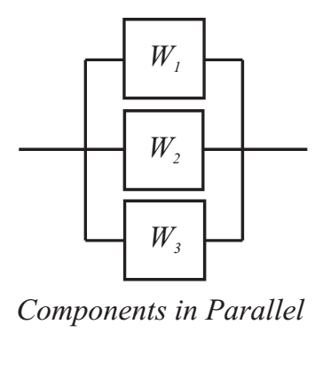
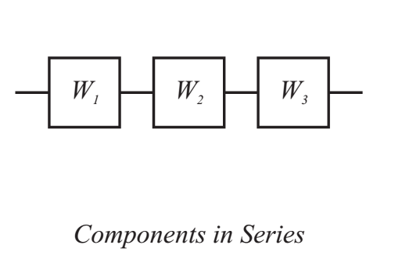
Components in Series and Parallel

Slide 2
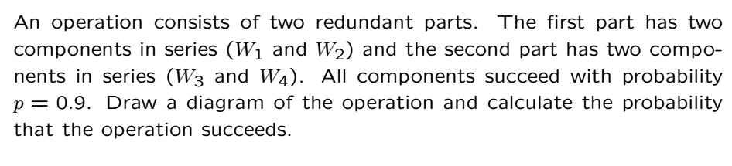
Example

Slide 3
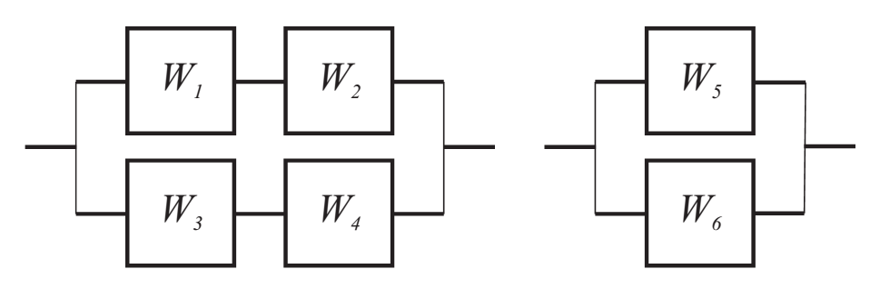
Solution
The Fig. on the right simplifies the one on the left

Slide 4


Solution Cont’

Slide 5
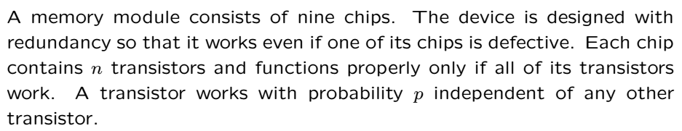
Example

Slide 6
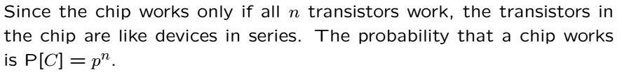
Example Part a

Slide 7
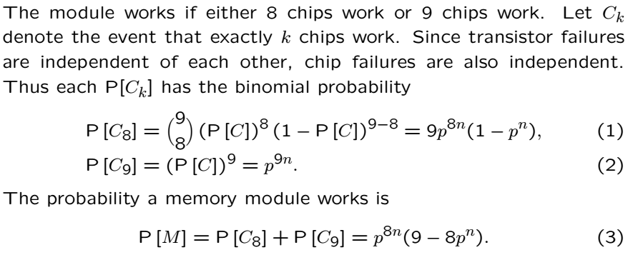
Example Part b

Slide 8
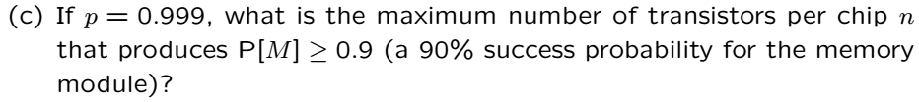
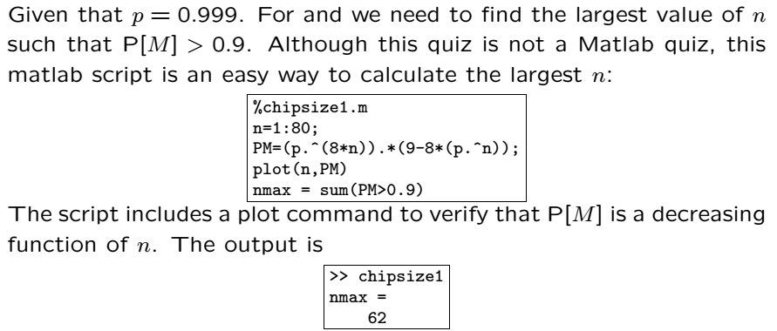
Example Part c

Slide 9
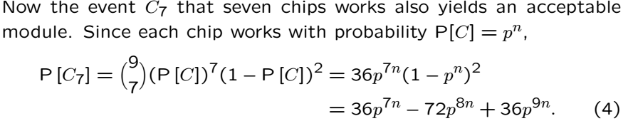
Example Part d

Slide 10
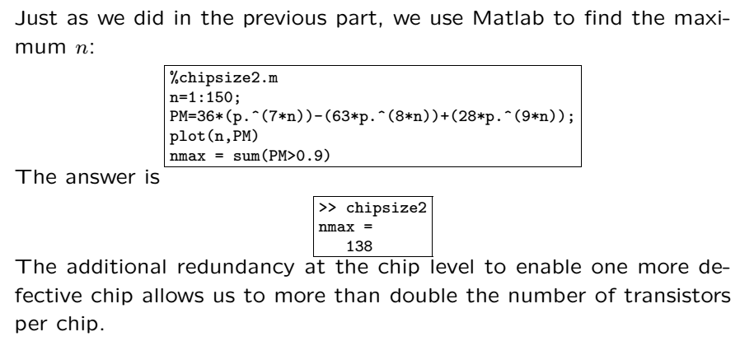
Example Part d Cont’

Slide 11
Acknowledgements and Citations
Parts of these slides are adapted from the following resources:
Power Point Lecture Slides for the Textbook http://bcs.wiley.com/hebcs/Books?action=index&bcsId=8676&itemId=1118324560
John Tsitsiklis. 6.041 Probabilistic Systems Analysis and Applied Probability, Fall 2010. (Massachusetts Institute of Technology: MIT OpenCourseWare),http://ocw.mit.edu (Accessed 13 Apr, 2015). License: Creative Commons BY-NC-SA

